Slide 1
An Introduction to RFgen Mobile Foundations for SAP
Presented by:
Sales Consultant

Slide 2
Agenda
What are the Challenges?
Advantages of Automation
RFgen Software Overview
RFgen Mobile Foundations for SAP
The Wireless Warehouse
How to Achieve 24/7 Continuous Operation
Voice-Enabling Your SAP Warehouse
Real World Results – A Few Customer Case Studies
Q&A

Slide 3
8 Challenges Solved with a Mobile Data Collection Solution
Growing Business
Margin Pressure
Government Regulations
Value from IT
Traceability
Accuracy
Scalability
Customer Service
Notes:
Growing Business
Your business is growing and needs to increase throughput to keep from having to develop or purchase more facilities.
Margin Pressure
Margin pressure from competitive market forces and increased costs is causing pressures to look for savings throughout the business.
Government Regulations
Faced with changing and expanding regulatory requirements, you need to ensure compliance with ePedigree requirements, maintain tracking of lot/batch/country of origin, comply with FDA Bioterrorism Act requirements and more.
Value from IT
You want to get more output from you existing IT infrastructure – without putting day-to-day operations at risk.
Traceability
You are being asked to support the Produce Traceability Initiative (PTI) to ensure complete produce traceability and support GS1 standards.
Accuracy
Providing more “perfect orders” is a top objective in enhancing customer service. To achieve this, you need to offer solutions for improving shipment accuracy and timeliness of delivery.
Scalability
You’re evaluating processes to keep pace with the growth of your online business and find a solution to address the line item order fulfillment business amid a changing mix of product shipments.
Customer Service
Your business continues to look for ways to provide competitive differentiators and customer service offerings.

Slide 4

Paper-Based and Manual Processes Create Inefficiencies

Slide 5

It also Makes it Difficult to Get Real-Time Visibility into Inventory

Slide 6
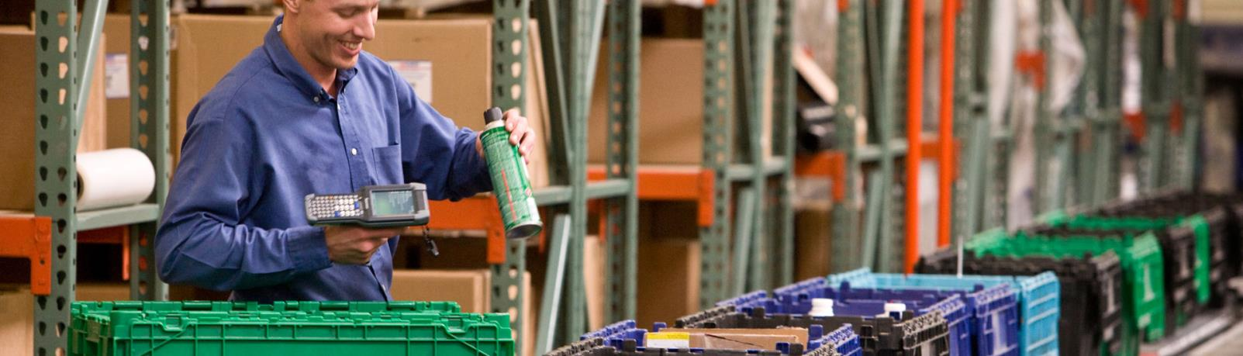
What You Need are Barcode and Mobile Solutions to Track Inventory in Real-Time

Slide 7
RFgen Software Overview

Slide 8

Who is RFgen Software?
Established in 1983
SAP-Certified Integration
Global Reach
SAP versions 4.6c to 6.05 and SAP HANA
2,800 worldwide installations
140 partners worldwide
Regional support in 35+ countries
Total Solution Provider
Certified Partner
Software
Hardware
Professional Services
SAP Partner
Oracle Gold Partner
Deltek Premier Partner

Slide 9
RFgen Mobilizes the Supply Chain
Integrated ERP Solutions
SAP
Supply Chain Accelerators
And More
Industry Solutions
Aerospace & Defense
SAP Business One
Deltek Costpoint
And More
Warehouse Automation
Voice Picking
Remote Warehouse Automation
Feed, Food & Beverage
Life Sciences
Oil & Gas
Retail
CPG
Engineering, Construction & Industrial Supplies
High Technology
Industrial Machinery & Equipment
And More
Asset Management
Barcode Labeling
Inventory Management
Field Service
License Plating
Oracle E-Business Suite
JD Edwards
Shop Floor Data Collection

Slide 10



The RFgen Mobile Framework
RFgen Software designs, implements and deploys mobile and wireless software, and open source supply chain solutions for automated data collection.
Barcoding
Voice
Roaming
Mobile

Slide 11
Where is RFgen Used?
Inside the Four Walls
Outside the Four Walls
Inventory Management
Warehouse Automation
Voice-Directed Operations
Manufacturing Operations
Field Service
Freight Yard Operations
Remote Inventory Management
Direct Store Deliver
Transportation and Logistics
Track and Trace

Slide 12

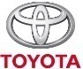


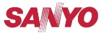

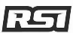
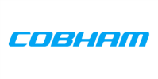






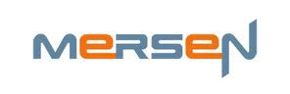








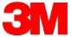

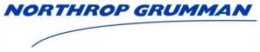

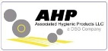

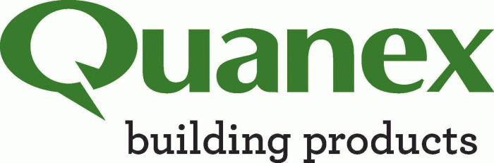



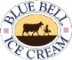
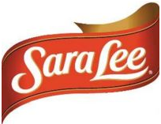


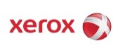



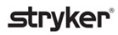











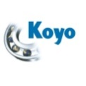

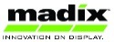








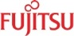
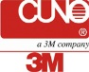


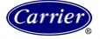








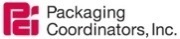

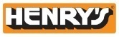



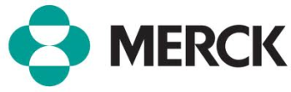
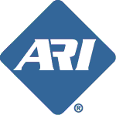








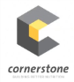



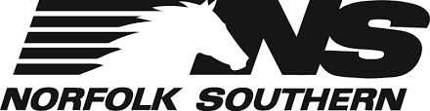

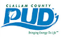




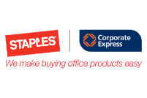
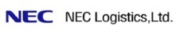









2,800+ Sites | 25+ Industries | 35+ Countries
Aerospace & Defense
Automotive
Consumer Packaged Goods
Electronics
Engineering & Construction
Feed, Food & Beverage
High Technology
Industrial Machine & Equipment
Life Sciences
Manufacturing
Oil & Gas
Pharmaceutical
Retail
Transportation & Logistics
Utilities & Energy

Slide 13
RFgen Mobile Foundations For SAP

Slide 14
RFgen Mobile Foundations for SAP
Mobile Application Development Platform
Tightly Integrated with SAP
Out-of-the-Box Pre-Written Pre-Tested Mobile Apps
Architecture Facilitates Rapid Modification and Configuration
Supports Multiple Data Capture Scenarios for Real-time, Mobile and Batch Workflows

Slide 15
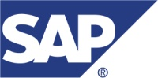
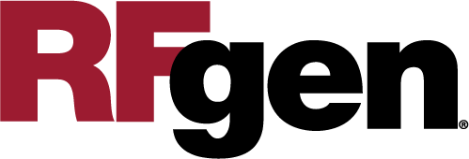
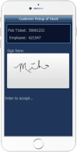
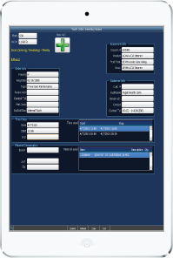

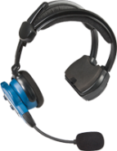
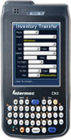
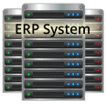
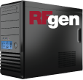

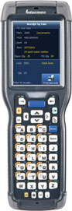
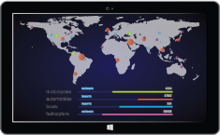
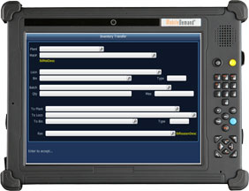
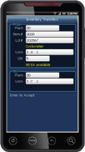
RFgen-SAP Integration at a Glance
Devices
Business Logic Integration
SAP BAPI
Data Integration
Business Data
Configuration Options
Real-Time Data Validation

Slide 16
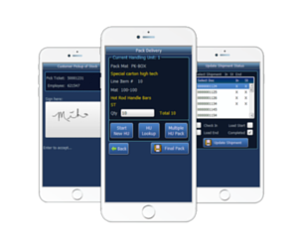
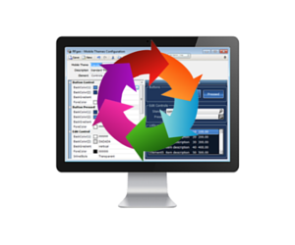
RFgen Framework for SAP
Pre-Built Mobile Application Suite
Certified and pre-tested mobile applications
RFgen Mobile Development Studio
Drag and drop visual environment
Integrate with other shop floor systems
Change pre-built mobile apps or build new ones
Implement out of the box or customize
Built using data collection best practices

Slide 17
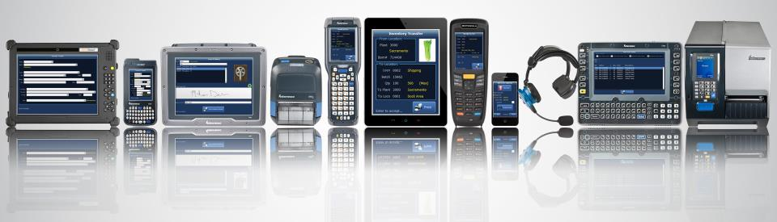
RFgen Extends SAP to Any Data Collection Device Type
Operating Systems
Windows Mobile and CE
Android
iOS
Telnet
Data Collection Devices
Barcode Scanners
Tablets and Smartphones
Vehicle Mount Computers
Voice Recognition
RFID
And More
Machine-to-Machine (M2M)
Carousels and Scales
Sensors
Meters
Robots
And more
Notes:
RFgen can not only work with Android and iOS devices, but we also work with older technologies using Windows Mobile, Windows CE, and Telnet.
We haven’t run into any device RFgen couldn’t run on, but if we do we will get that device running at no charge.

Slide 18
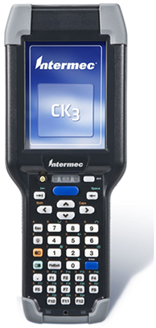
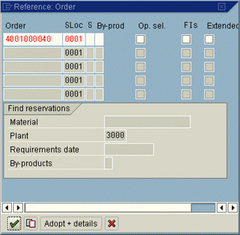
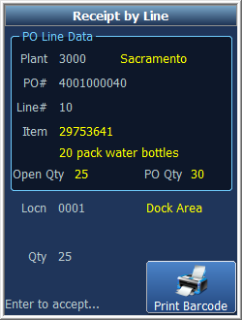
RFgen-SAP Integration
RFgen on a Mobile Device
SAP Screen
All data is validated against business data in SAP.
All transactions are executed using SAP’s BAPI.
Notes:
Jeff

Slide 19
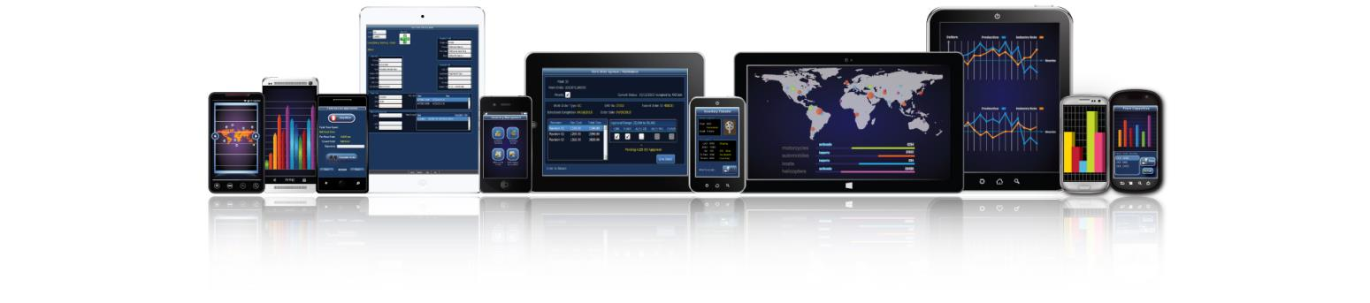
Pre-Built SAP Mobile Apps Included
CUSTOMIZE AND CREATE YOUR OWN MOBILE APPS!
Inventory Management
Sales Orders
Purchase Orders
Production Orders
Plant Maintenance
Warehouse Management

Slide 20
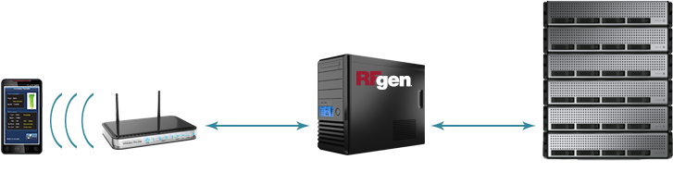
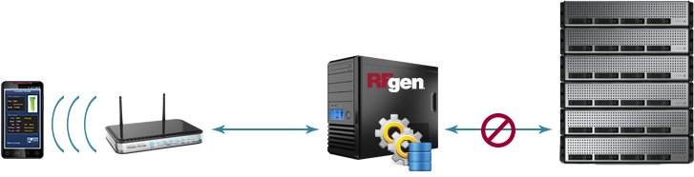

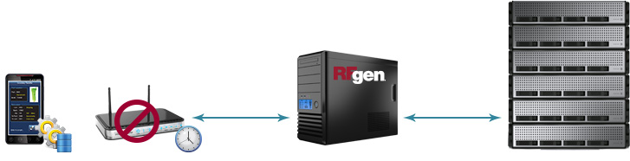
RFgen Connectivity Scenarios
Real-Time
High Availability
Offline Mobility

Slide 21


Deployment Options
Onsite use license
Eliminates privacy and security concerns
No capital expenditure
Annual payments
Minimizes internal IT requirements to deploy and manage
Run RFgen in your IT infrastructure
Maintain complete control of your entire RFgen platform
Manage complex data, analytics, or big data sets including networks, analysis, image services, or real-time sensor streams

Slide 22

Zero Footprint on SAP Means Hassle-Free SAP Upgrades
Nothing to Reinstall
The RFgen version is the same regardless of the SAP version.
RFgen Can Reduce Custom Modifications
Move custom modifications from SAP to RFgen.
RFgen is Non-Invasive
Simply redirect RFgen to the new environment and begin UAT.
No custom objects within SAP to upgrade or retrofit.
Eliminates the need to retrofit.

Slide 23

RFgen Implements in Weeks, Not Months
Open Source Code Samples
Rapid Application Development Platform
No Cryptic Scripting Language
Uses Data Dictionary Aliases
Reusable Objects
Interactive Debugger
Built-in SQL Testing
Deploys Instantly to All Devices
Notes:
RFgen is simple to implement. Typical implementation time is 4-6 weeks.

Slide 24
The Wireless Warehouse

Slide 25

RFgen provides real-time, wireless connectivity to a wide range of systems and supports numerous warehouse operations like:
Inventory management
Receiving
Picking, packing and shipping
Manufacturing
Quality assurance
Time and attendance
Wireless and Mobile Data Collection

Slide 26


Case Study
Company:
Industry:
Application:
Environment:
NB Coatings
Automotive Paint and Coatings
Inventory Control
SAP
The RFgen Solution:
Reduced TCO implementation costs by $200K.
Maximized ROI by eliminating $100K per year in manual administrative costs.
Obtained user‐friendly barcoding system that required practically no training and maintenance.
NB Coatings manufactures paint-on-plastic solutions, allied products, cyclic crudes, and intermediate inorganic pigments for the automotive industry.
Notes:
NB Coatings Automates Inventory Control with the RFgen Framework
Design and implement entire new IT infrastructure after company acquisition
Deploy new SAP system and bar coding application in very short timeframe
Results
Met short implementation deadlines through RFgen’s simple processes for designing, testing, and deploying applications with built‐in functionality
Reduced TCO with implementation costs $200K less than competitive products
Maximized ROI by eliminating $100K per year in manual administrative costs
Obtained user‐friendly bar coding system that requires practically no training and maintenance
The Leader in Paint‐On‐Plastics
NB Coatings Inc. (NBCi) is the leader in the North American plastic automotive coatings market. The company was formed on October of 2006, when Rohm and Haas sold its Automotive Coatings Division to Nippon Paint. Using the industry's most innovative technologies, NBCi serves automaker's ever‐advancing needs for high performance and cost effective paint‐on‐plastic solutions.
As a result of the 2006 acquisition, NBCi was forced to undergo a complete IT infrastructure redesign. The division’s previous parent company (Rohm and Haas) had maintained all servers, performed all network administration, and managed everything to do with the SAP and the bar coding application at its Philadelphia data center. As part of the purchase agreement, the division was to be completely divested from Rohm and Hass’s computer systems by June 1st of 2007. NBCi needed to have all of its own servers, applications, and network administration in place and operational by the deadline.
NBCi needed to develop a new bar coding solution for use in its plant, and bring all database servers, print file servers, and email applications back in‐house. The division’s IT team had to purchase new SAP licenses, perform the implementation, and go‐live in just six months. “We were faced with an enormous challenge – implementing an entirely new ERP environment in just under six months,” explained Mike Crowley, Business Analyst /Programmer, NB Coatings. “That’s a very short period of time to make that many changes – especially considering we didn’t have extra re
“The RFgen system is very user friendly and its performance is rock‐solid. It was fast to implement, easy to use, and almost effortless to maintain. We couldn’t be happier with the solution!”
Michael R. Crowley, Business Analyst /Programmer, NB Coatings
Adding the RFgen Bar Coding Application
After all major infrastructure decisions were made, NBCi began looking for a bar coding solution that would work with its new SAP infrastructure. Mike started by looking at the data collection solution that had been used at Rohm Haas. The division was familiar with that application from an end‐user standpoint, but since it had been managed at the parent company’s central datacenter, the division had no experience with the implementation and management of the SAP console solution.
“The driving force in our selection was the economics – both short‐term with the acquisition and implementation costs, as well as the long‐term overhead of administration and maintenance,” explained Mike. “We compared the TCO of several data collection solutions, and quickly realized that the RFgen Framework would be able to offer us a better ROI than any of the competitive options.”
The application implementation was performed by RFgen developers. NBCi already had the hardware for the new RFgen application, including bar code scanners and the antennae from the acquisition. The RFgen developers worked closely with Mike on transaction configuration and encoding. “The only thing we had to do from our end was set up a relatively small Windows server and install the software,” explained Mike. “With the help of the RFgen developers, the system went live after only six weeks.”
“Any time you are forced to do an ERP implementation quickly, it can get pretty crazy,” admitted Mike. “The reason RFgen was such a success story for us was that my involvement was minimal – which was great because of my other IT obligations. Most of our involvement was limited to setting up access permissions for RFgen developers. Our end users were able to test the new system almost immediately, with training provided during a few short WebEx sessions.”
The RFgen System in Action
The application came up strong with no issues. “There were only a few very minor tweaks needed and I was able to do them all myself very quickly,” stated Mike. “We can now track all 15,000 different materials with our SAP system – 3,000 on a daily basis. We record all warehouse transfers, material movement, inventory checks, goods issued to cost centers, and goods issued to process orders using the RFgen system.”
“We have 400 licenses with SAP in our company, of which 35 are used for the RFgen application,” stated Mike. “On average, there are 25 people using the system at one time through the hand‐held devices and the RFgen Windows client that is loaded onto a PC. Our end users can now perform approximately 2,500 transactions per day quickly and error‐free with the RFgen system.”
Streamlining Operations and Saving Money
The RFgen solution has been very cost effective for NBCi. “The upfront costs of the software and for developers to create transactions to our specifications were very low. We started with RFgen‐supplied open source transactions. Most were modified slightly to accommodate some of the unique things we wanted to do, to ensure that our end‐user operators were gathering all of the right information.”
The ongoing maintenance – consisting only of small modification to the transactions – Mike is able to do by himself. “RFgen is a very user friendly system for developers,” explained Mike. “This is in contrast to some of the arcane scripting requirements of the SAP console. RFgen uses Visual Basic, making it very easy to find people who can work with the software. The tough stuff, like integration with SAP – is handled in the background. I just make small changes to ‘If’ statements and other simple programming tasks.”
“We are a 500‐person operation with annual sales over $150M,” stated Mike. “Our savings during the RFgen implementation stage alone were in the range of $200K compared to the competition. We also did some studies to calculate the ROI of the RFgen solution. Compared to manual inventory methods, the solution enables us to eliminate two full time headcount that would have been required to manually handle all of the clerical transactions for our warehouse and manufacturing groups. This saves us approximately $200K per year in ongoing headcount expense.”
“The RFgen system practically administers itself. All user logins are handled through SAP. Once the software is installed on the server – just a standard Windows server – all training on the transactions is done by our front line supervisors. I never have to get involved. The average user can pick up the hand gun cold and follow the prompts without receiving any training at all. We keep the system pretty locked down as to what end users can do, so we can maintain the integrity of the system.”
Moving Forward
With the complete success of the RFgen implementation and its ease of use on the factory floor, NBCi is now looking to expand the use of the solution. “One of the selling points for us when considering the RFgen solution was the ability to use the software for other divisions and applications across our company. One of our first targets is automating our consignment inventory for our largest customers. “The RFgen system is very user friendly and its performance is rock‐solid,” concluded Mike. “It was fast to implement, easy to use, and almost effortless to maintain. We couldn’t be happier with the solution!”

Slide 27
How to Achieve 24/7 Continuous Operation

Slide 28

RFgen provides the ability to continue operating 24/7, even when the host system is unavailable.
Remote and off-shore locations
Poor/occasional connectivity
Disconnected environments
Nightly/weekly back-ups
100% transaction visibility
High Availability Disconnected Solutions

Slide 29


Case Study
Company:
Industry:
Application:
Environment:
Royal Dutch Shell PLC
Oil and Gas
Off-Network Mobility
SAP
The RFgen Solution:
Allowed for operations on remote ocean platforms.
Automated local inventory control and visibility.
Provided method for synchronization to central ERP.
Guaranteed transaction delivery and execution.
Shell is a global group of energy and petrochemical companies with 92,000 employees in more than 70 countries and territories including off-shore oil platforms and deep sea drilling rigs.

Slide 30

RFgen supports mobile on-demand access to your data from any Windows, Android or iOS device.
Vendor managed inventory
Product returns
Drop ship
Proof of delivery
Direct store delivery
Field service/sales
Batch (yards, freezers, etc.)
On-Demand Mobile Enterprise Connectivity

Slide 31


Case Study
Company:
Industry:
Application:
Environment:
Southern California Edison
Public Utility
Inventory Control, Off-Network Mobility
SAP 6.0
The RFgen Solution:
Enables data capture in remote environments—outside of wired or wireless networks.
Allows drivers to track where they've been and what they've delivered.
Mitigates the loss of high-value items from inventory.
Helps them avoid costly scheduling mistakes with repair crews.
As one of the nation’s largest electric utilities, Southern California Edison deliver power to more than 14 million people.
Notes:
Read the case study at: http://www.rfgen.com/sap-barcode-software-case-study-ca-utility/

Slide 32
Voice-Enabling Your SAP Warehouse

Slide 33

Hands-Free, Eyes-Free Warehouse Operations
The RFgen-Vocollect Voice Solution provides hands-free, eyes-free warehouse operations, helping you achieve:
10-25+% productivity gains
Up to 99.99% accuracy
Improved safety
Increased job satisfaction
Reduced training costs

Slide 34

What is Voice-Directed Work?
Perform step-by-step tasks and collect data using voice prompts and worker voice responses.
Wireless technology with direct integration into back-end systems.
Hands-free, eyes-free.
Designed for noisy, industrial environments and diverse users.
Focused on order selection/picking.
Expandable to other applications: fork lifts, line loading, cycle counting, put-to-store and more.
Notes:
34
34

Slide 35
Voice Provides Real-World Results
Voice-Enabled Picking
>20% improvement in productivity
Voice-Enabled Put Away and Replenishment
20% increase in productivity while increasing volume
Voice-Enabled Loading
Voice-Enabled Receiving
Up to 99.95% order accuracy
50% reduction in training time
52% improvement in replenishment rate (pallet/hr)
67% reduction in training time
>20% increase in productivity while increasing volume
Reduced floor space—doors turn faster
Eliminated double-check by a supervisor before receiving is complete
Allowed use of labor standards with data capture

Slide 36


Case Study
Company:
Industry:
Application:
Environment:
Caito Foods
Produce Distribution
Food Traceability, PO Processing, License Plating
Inventory Management, SO Processing, Voice Picking
JD Edwards EnterpriseOne 8.XE (upgrading to 9.1)
The RFgen Solution:
License plating improved traceability and enabled full field-to-fork GTIN tracking and the delivery of country of origin information to customers.
RFgen audit trail enables them to easily pass government audits.
Voice technology helps prevent cross-contamination and expedites picking and shipping.
Improved efficiency in receiving, put away and inventory replenishment processes.
Founded in 1965, Caito Foods operates four distribution centers that send fresh produce to multiple states in the Eastern, Midwestern and Southeastern United States.
Notes:
Read the case study at: http://www.rfgen.com/jde-barcode-software-case-study-caito-foods/
Notes from interview with IT manager:
It’s now easy to pass an audit using RFgen – RFgen gives us an audit trail
We can now comply with regulations
Country of origin tracking
Different County of Origins can be consolidated to one item instead of 15 scans – reduces it down to 1 with license plating
GTIN# sent attaches to item and to the field – links to vendor and field – enables field-to-fork traceability
If there is a recall, GTIN will link back to the field where the product came from
PTI = Produce tracking initiative
Prevent cross-contamination with allergens
Verify that organics stay where they are supposed to be
IP transfer
Moving
Trace and give customers an invoice
RFgen enables you to customize the system to eliminate steps
Very flexible to change and get it up and running
Easy to modify
Eliminates errors that were found
Put in check points along the way
Complete visibility of where products are at at all times from receiving to shipping
Make you more efficient
Most important! It integrated into ERP linking everything into the financial and accounting information

Slide 37
What Our Customers Are Saying
“RFgen offered a full suite of solutions that had at least fifty SAP-specific transactions straight out of the box that could be used without being connected to a network. Whenever drivers returned to wireless range, we could upload that information as if it had happened in real time.”
Prashant Agrewal Southern California Edison
“RFgen could answer the needs we had back then and will continue to answer for any future changes, so it was a good fit. We are going to transition from SAP to Oracle in the next year, and RFgen was adaptable for both ERP systems. It offered more bang for our buck.”
Tony Navarro Cobham Defense Electronics
“RFgen brings the ERP functionality from SAP to the shop floor and Metrack manager adds user management, logging and reporting capabilities to it. Should the connection fail in lesser technological countries, the factory is able to keep running on RFgen regardless.”
Mohamed Seali Provimi

Slide 38
RFgen is a Total Solutions Provider
RFgen
Software
Hardware
Professional Services
Support
SAP-certified integration with SAP ERP
Suite of pre-built mobile apps
Mobile development studio for fast and easy application development
24/7 technical phone support
24/7 online support and resources
Classroom and online training
Certified reseller of major mobile device and hardware brands
Windows, Apple iOS and Android
Single vendor accountability
ERP integration expertise
Mobility and automation expertise
Supply chain and industry expertise

Slide 39
How [Prospect] Wins with RFgen
A solution for right now
Implement a SAP-certified solution for SAP that will meet your organizations exact needs for automated data capture today.
A solution that will evolve with you
Integrate multiple (disparate) systems and multiple ERP systems.
Integrate with third-party inventory management solutions.
Integrate with multi-carrier shipping and automated equipment.
Add new workflows, new product lines and new facilities.
Achieve a low total cost of ownership and quick ROI.
Administer one single-source platform for all your mobility and automation needs.
Manage and maintain one platform with minimal effort.
Easily upgrade your front-end systems when you upgrade your SAP system.
A solution that provides value

Slide 40
Questions?
Contact
call | TBD
email | TBD
visit | TBD

Slide 41
Other Slides

Slide 42
The Advantages of Automation
Mobile Data Validation and Processing Against SAP
Multiple options to meet your requirements:
Endless Mobile Worker Possibilities
Proof of delivery signature capture
Direct connect
Connect-on-demand
Batch on- and off-line (hybrid solutions)
Mobile field service
Sales order creation
Asset tracking/warranty tracking
Automation of Warehouse Activities
Eliminates manual processes
Increases data accuracy
Increases employee productivity
Real-time data validation and processing
Notes:
If you have a mobile workforce, RFgen’s mobile data validation and processing against JD Edwards gives you multiple options to meet your requirements including:
Direct connect, where you have a direct connection to your RFgen server via a 3G/4G device or smart phone.
Connect on demand, which allows you to collect transactions in a disconnected mode and then send those transactions to the RFgen server at your convenience.
Batch on and offline, which is a hybrid of direct connect and connect on demand.
There are endless mobile worker possibilities. Things like:
Proof of delivery signature capture, where you might have your own delivery fleet.
Mobile field service that allows you to track your parts inventory and transact against repair or service orders.
Sales order creation and customer service applications for your mobile sales force.
Asset tracking and warranty tracking for assets that may be in offsite locations.

Slide 43
Mobile Data Collection by the Numbers
Faster Training
Increase in Productivity
Increase in Efficiency
Increase in Accuracy
99%
25%
30%
80%

Slide 44
How is RFgen Different than a WMS?
WMS
Typically a combination of a desktop and handheld application.
A separate system with its own separate database.
Requires data synchronization between the ERP and WMS, which requires some management because you have two separate databases.
RFgen
An add-on mobile data collection software solution to the ERP.
Does not require a separate database because it processes transactions in real-time against the ERP.
A system that extends the functionality of the ERP onto a mobile device.
Typically has its own set of business rules and configuration that must be set up and managed.
A solution that utilizes the data and business rules already setup in the ERP.

Slide 45

RFgen’s SAP Consulting Team Core Competencies
Senior level consulting expertise in business processes for SAP.
Extensive knowledge of industry-specific best practices for automated data capture and warehouse management solutions.
Real-world, hands-on experience with multiple data capture technologies and process workflows.
Ability to plan, prepare, design, and deploy solutions that deliver desired results.

Slide 46

Around the Clock Technical Support
RFgen technical support experts are on-hand 24 hours a day, seven days a week.
Toll-free number gives you instant access to an RFgen technical expert, ready to help you get your applications back up and running.
For non-urgent issues, submit an online help request or search the RFgen Online Knowledgebase.
Join the RFgen LinkedIn User Community and gain access to others using RFgen.

Slide 47

RFgen System Architecture

Slide 48


RFgen Architecture On-Premise
RFgen On-Premise
Scenario 1
RFgen On-Premise
Scenario 2

Slide 49

RFgen Architecture In the Cloud
RFgen in the Cloud

Slide 50

RFgen Connectivity Scenarios
RFgen in or Near the Plant

Slide 51

RFgen Application Framework

Slide 52
[Prospect Name]’s Business Challenge

Slide 53

[Prospect Name]’s Business Challenge
Briefly describe the prospect’s business challenge
Text
Text
Text

Slide 54

[Prospect Name]’s Expected Project Deliverables
Briefly outline what they hope to get by automating
Text
Text
Text

Slide 55



[Prospect Name]’s Requirements
Requirement | RFgen Meets Requirement
Text
Text
Text

Slide 56

How will RFgen Meet all of Your Requirements?
The flexibility and robustness of the RFgen Mobile Framework enables us to meet all of [Prospect Name]’s requirement for warehouse automation and mobility.
Let’s take a look at RFgen Mobile Foundations for SAP.

Slide 57
Summary of Your RFgen Project
Turn-key solution for warehouse automation for the workflows listed to the right.
Meets the unique or specific requirements of each of the four distribution centers.
If there are other areas where efficiencies can be created we can incorporate them into this project very easily.
This solution can provide a mobile field sales application for your 250+ field reps.
Create increased efficiency / throughput
Reduction of direct labor
Increased inventory accuracy
eliminate manual processes and data entry
RFgen is very flexible and scalable
Transactions Includes in RFgen Solution
RFgen Distribution Suite
Cycle Count
PO Receipt by PO/Line
RFgen Warehouse Management
Warehouse Director
Put Away by Item
RFgen License Plate Suite
Create Entity
Assign Entity
Create LP Type
Create Plate
Attach Plate
Detach Item
Transfer LP
Pick, Pack, Ship (Outbound)
Pick to Plate
Ship Confirm Plate / Load
RFgen Inquiries
Item/Location Inquiry
Location Inquiry
Supply/Demand Inquiry
PO Inquiry by Item / Line

